Slide 1
Chapter 8 and 9

Slide 2
5-8th grade students
All classroom teachers
Principal
Assistant principal
Councilor
ISS teacher
Secretary
Parents
PLC teams
All assignments
Use google docs
Use SISK-12
Record all late assignments in spreadsheet
Gather data
Assign lunch study detention
Take necessary discipline steps
Use clubs and sports teams to gain leverage
Make parent calls
Reduce the number of 0’s in the grade book
Produce more passing grades
Improve student performance on standardized tests
Have students ready for High-school
*HS has reported higher 1st semester grades and less incidents of 0’s since ZAP program inception
inputs
process
outcomes
Zeroes Are Preventable

Slide 3
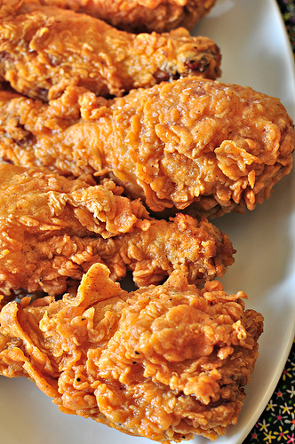
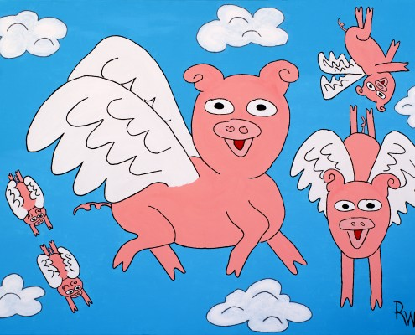

Slide 4
Democrats | Republicans
Rule by the people (everyone votes) | Rule by the select few (more careful of citizenship and voting)
Strong (large government) | Strong state (small national government)
Emphasis on service economy, and government based jobs, and labor unions | Emphasis on manufacturing, agriculture, de-regulating business, and against labor unions
Loose interpretation of constitution especially on gun rights and citizenship | Strict interpretation of constitution especially in gun rights and citizenship
French Alliance (sounds about right) | British Alliance the British have similar beliefs about the military and economy.
In Favor of regulation of trade and financial institutes | In favor of deregulating trade and punishing ones who were in charge during the financial crisis of 2008
Free trade | Free trade for some/ with some protection for certain industries

Slide 5
Preview of chapter 8 and 9
Look through all of the sections in chapter 8 and 9.
What do you think the sections main theme might be?
What do you want to learn about American history from this era? (list as many as you want but at least 3)

Slide 6
Essay test
Write an essay that details Missouri’s History. Begin in Pre-written History and explain all the way through modern time. Be sure to include details about Natives, Early Explorers, Early Settlements, Louisiana Purchase, Statehood, civil war, and current constitution.
Write an Essay that details all of Missouri’s superlatives. (state tree. State flag. State seal. State animal etc. etc.)
Write an essay that describes the government that represents you today. Be sure to tell who your representatives in congress and general assembly are. Detail your governor and as many other positions and districts as you can think of.
Write an essay that explains the way power is shared in our state government. Be sure to explain the checks and balances and the requirements of each office.

Slide 7
Daily Work. Read Chapter 8.1 Find the three most important facts in this section. Write them out and then using details, explain why they are the three most important facts from this section. You have a rubric. USE IT.

Slide 8
Daily Work. Read Chapter 8.2 Find the three most important facts in this section. Write them out and then using details, explain why they are the three most important facts from this section. You have a rubric. USE IT.

Slide 9
Spoiler alert
Steve kills Skeeters hunting dog in an accident causing the breakup of their friendship.
Jk

Slide 10
Daily Work. Read Chapter 8.3 Find the three most important facts in this section. Write them out and then using details, explain why they are the three most important facts from this section. You have a rubric. USE IT.

Slide 11
Bear time teaching activity
Read chapter 9.1 9.2 9.3 or 9.4. 5 pts.
Outline the 3 to 5 most important parts of it 5pts.
Create a lesson that you could teach to the class to teach them this material. Make it 10 to 30 min long. It can include reading, discussion, an activity, notes,partner work etc… 10 pts.
Create an assessment that you could use to determine if the class learned the material. It will need an answer key as well. 5 pts
Teach it to the class when we get there 0-25 bonus points split up evenly among your bear time and social studies class.

Slide 12
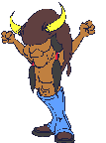
Chapter 8.1 most important things
1st cabinet was established
Financial problems including national debt
National Bank was created
The Bill of Rights (1st 10 amendments) were added to constitution.

Slide 13
Chapter 8.2 most important things
Whiskey rebellion was a rebellion started over taxes on whiskey.
The Americans fought with Native Americans in a struggle over the West.
Spain and America didn’t get along. Also Britain and France were annoying America these were problems in Europe.
Washington only served two terms.

Slide 14
8.3 most important things
Federalists and Democratic Republicans had different views and constantly were at odds.
Xyz affairs France was pushing us for a war and three officials knowns as x y and z were spying on us.
The Virginia and Kentucky resolutions tried to give power to the states over the federal government.
The treaty with France hurt Adams re-election

Slide 15
Louisiana Purchase
You may work with a partner Explain the Louisiana Purchase.
Explanation | 1 point | ½ point | 0 points
Explain the events leading up to the purchase | 3 events leading up to the purchase (1point) | 1-2 events (1/2 point) | 0 events (o points)
Tell about how we acquired it. | Tell the people involved and other details like amount of money (1 point) | Tell about either the people involved OR the details (1/2 point) | Tell no details about how we acquired the LA Purchase. (o points)
How did the Louisiana Purchase affect America | Explain how it changed politics and our settlement (1 point) | Explain how it changed politics OR our settlement (1/2 point) | Provide no details about how it changed America (0 Points)

Slide 16
Essay from last time.
Use the rubric to grade your partners essay.
Find one area that they can improve.
Explanation | 1 point | ½ point | 0 points
Explain the events leading up to the purchase | 3 events leading up to the purchase (1point) | 1-2 events (1/2 point) | 0 events (o points)
Tell about how we acquired it. | Tell the people involved and other details like amount of money (1 point) | Tell about either the people involved OR the details (1/2 point) | Tell no details about how we acquired the LA Purchase. (o points)
How did the Louisiana Purchase affect America | Explain how it changed politics and our settlement (1 point) | Explain how it changed politics OR our settlement (1/2 point) | Provide no details about how it changed America (0 Points)

Slide 17
Look at chapter 9.1 and evaluate Thomas Jefferson on his political agenda.
Use grading scale like A, B, C, D, F It is possible to not get a grade for one of the elements. We will do the same bell ringer for 9.2 some are covered there. Write a sentence explaining each grade!
_____ cut debt and cut spending
_____ reduce size of government
_____ let people govern themselves
_____ States rights over federal rights
_____ expanding westward
_____ cut the military spending.

Slide 18
Ms. Duddridge Obj. Be able to describe events in the war of 1812 and how it ended.
Bell ringer- lowest point of the war
Read the section in small groups
Write 3 important events
Write a national anthem (5 to 10 lines of song) about events that have taken place in American history recently (9-11, obama, trump, war in iraq) DO NOT BE OFFENSIVE. Use the same tune as Star Spangled Banner

Slide 19
D. Francis Scott Key
A. James Madison
B. Andy Jackson
E. Treaty of Ghent, Belgium
C. Battle of Nawleans
General William Hull
War Hawks
Native Americans

Slide 20
War of 1812
Pick a time during the war that was the lowest point for
America
Britain
Explain why it was the lowest point of the war for that side.

Slide 21
Jaron Storeeey Objective: Students will learn about the War of 1812.
Jaron split the students into groups of two to read the section.
20 questions about this section
Did summarizing activity with the class.
Great understanding of your material.
Its hard not to get frustrated when the kids aren’t getting it. You did pretty well.

Slide 22
Thigh Meas….les

Slide 23
Mr. Bailey OBJ> learn about election of 1800
1. Read 9.1 don’t read the last two sections. Discuss what you read.
-good job monitoring the reading.
-Explained instructions clearly
-answered questions
Activity went well. Most kids knew that the plan wouldn’t work because Mr. Perkins had mentioned it earlier.
Quiz was challenging but fair.

Slide 24
Mr. Davis Obj. learn about Louisiana Purchase events
Popcorn read
Notes:
When America first wanted to buy the land the French were a threat.
When Jefferson purchased the land he sent Lewis and Clark to find and discover trade routes.
When Napoleon took control of Haiti he called it Santo Domingo, after the slave revolt, it was renamed Haiti.
Burr and Hamilton were going to face each other in a dual because Burr blamed Hamilton for losing the election.
Burr killed Hamilton in the dual and ran away.

Slide 25
Mr. Wake Objective; teach students anything about Louisiana Purchase
1. split into 8 teams. Each team will read the heading and then summarize their heading and share their summaries.
Good activity.
Split teams fairly
2. Afterwards, we will try to determine the main idea of the sections and the whole group.
What is the main idea of the whole section (small group discussion)

Slide 27
Mr. Jones obj. learn the main parts of the Louisiana Purchase.
Read each section and discuss each section after reading it.
Good questions about each section
Pick up with Lewis and Clark
Read the section and spoke about each section

Slide 28
Mr. Callaway objective: learn main components of war on Britain and Embargo Act
Pick groups using names
Read chapter 9.3 in small groups
Answer questions about the section while playing a game

Slide 29
Western territory
Kassidy and Heidi (good)
French threat
Jakobee and Dclan (didn’t get it)
Revolt in Santo Domingo
Chris and Justin (good)
Nation Expands
Claryse and Erica Leanne and McKenzie (good)
Lewis and Clark
Dakota, Devan, Sarah, Kaitlyn (g00d)
Pike’s expedition
Imilie, Chyann, Jenna, Conner (good)
Federalist plan to secede
Cole, Noah (good)
Burr and Hamilton
Will Shyanne (good)

Slide 30
Mrs. Scarbrough Objective: know information about Louisiana Purchase
Read 9.2 silently
Group 1.
Brenan, kole, david, cadee, riley, rosie, devin
Buying Louisiana territory
Group 2.
Brody, emily, leonard, trevor, erika, alexa, katelyn
Lewis and Clark
Group 3.
Nathan, wyatt, ethan, jaron, adalia, kaitlynn,
Burr and Hamilton
Make a short skit to perform about the section she assigns
Must include the important people and events
Must be accurate
Must use all group members in some way

Slide 31
Ms. Sigears Objective: Learn about Louisiana Purchase and Lewis and Clark expedition
Listen to teacher read section 9.2
Excellent explanation of material especially material not in the book. Good research Autum!
Good question and aswers.
5 Tricky questions:
What were Lewis and Clark’s last names?
When did Lewis and Clark explore the Mississippi river?
How much taller is Grand Peak than Pikes Peak?
Why did Alexander Hamilton kill Aaron Burr?
Napoleon bought Louisiana for how much?

Slide 32
Which country was a threat to America before purchasing this land?
Russia, France, Germany, Iraq
2. Who did Jefferson send to discover the new land?
Ben Franklin, Alexander Hamilton, George Washington Lewis and Clark
3. Pikes peak is located in which state?
Missouri, Texas, Colorado, New Mexico
4. Who died when Burr and Hamilton dueled?
Hamilton, Franklin, Burr, Lewis and Clark
5. Santo Domingo was renamed?
Jamaica, America, Haiti, Afghanistan

Slide 33
Vocab 9
3. customs duties
4. Impressment
5. frigate
7. laissez-faire
8. embargo
9. privateer
11. secede
1. judicial review
2. neutral rights
6. nationalism
10. tribute
12. They were covered wagons pulled by horse or oxen. They were the method settlers used to move west.
13. They were republicans who were in favor of war with Britain.

Slide 34
9.1
Thomas Jefferson's policy is LAISSEZ-FAIRE.
Jefferson’s secretary of state was JAMES MADISON.
Jefferson’s secretary of treasury was ALBERT GALLATIN
Jefferson’s running mate in 1800 was AARON BURR
The chief Justice was JOHN MARSHALL
D. The election of 1800 was decided by THE HOUSE OF REPRESENTATIVES.
A. Regional courts were set up for the United States with the JUDICIARY ACT OF 1801.
C. MARBURY V. MADISON was the case responsible for the Supreme Court ruling on acts.
B. JUDICIAL REIEW has become a basic power of the government.
A. or C. Many Federalist beliefs in the American System were incorporated by THOMAS JEFFERSON AND JOHN MARSHALL. Republicans specifically war hawks.

Slide 35
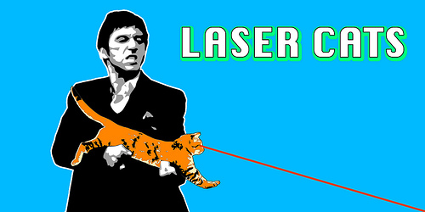
9.2 quiz
The area west of the Mississippi River is called the Louisiana Territory.
New Orleans is a trade center.
Napoleon Bonaparte was France’s leader.
Toussaint-Louverture was a revolt leader.
Sacagawea was Lewis and Clark’s guide. And an African American named York also accompanied the group.
6. B. Before it was transferred in 1802 Louisiana Territory belonged to SPAIN.
D. After it was secretly transferred, the Louisiana Territory belonged to France.
D. The size of the United States doubled with the Louisiana Purchase.
C. The Grand Peak was named after the explorer Zebulon Pike.
B. Alex Hamilton died in a duel. After being shot by Aaron Burr

Slide 36
Vocab
Cabinet
National debt
Bond
Speculator
Tariff
Impressment
Partisan
Caucus
Alien
Sedition
Deport
Nullify
Precedent is another word for tradition
Unconstitutional means inconsistent with the constitution
Neutrality is not choosing a side
States rights limited the federal governments powers
Implied powers are powers not expressly forbidden by the constitution
Inauguration is a ceremony that puts an official into office. .

Slide 37
8-1
C. Precedents are traditions
E. Randolph was 1st attorney general
A. The national debt is how much the country owes.
B. A tax on imports is a tariff.
D. Henry Knox was 1st secretary of war.
6. B. The nation’s 1st vice president was John Adams.
7. C. One of the liberties guaranteed in the Bill of Rights is freedom of speech.
8. D. The 1st Chief Justice of the US was John Jay.
9. C. The Judiciary act of 1789 established a federal court system.
10. A. By the 1790’s 90 percent of revenue came from tariffs.

Slide 38
8-2
Whiskey Rebellion was a tax protest. B.
Thomas Jefferson was Pro-French. D.
Neutrality means to not take sides. A.
Impressment means forced into slavery. E.
Pinckney’s treaty was an agreement with Spain. C.
6. Alexander Hamilton’s taxes led to a rebellion in Western Pennsylvania. B.
7. Around 1794 the British began building a new fort in Ohio. A.
8. The treaty of Greenville opened most of Ohio to settlers. D.
9. French and British warships were barred from American Ports by the Proclamation of Neutrality. D.
10. George Washington considered political parties to be a danger to the new Nation. C.

Slide 39
8-3
Political parties are factions. E.
Nullify means to legally overturn. C.
Charles de Talleyrand was the French foreign minister. B.
Alexander Hamilton was a Federalist. A.
Thomas Jefferson was a Democratic-Republican. D.
6. The Federalists wanted a strong Government. A.
7. Republicans feared a strong Government would endanger peoples rights. C.
8. The 2nd president was John Adams. C.
9. The Virginia and Kentucky Resolutions posed a challenge to the Constitutional authority. D.
10. The treaty with France divided the Federalist and hurt John Adams’s chance for reelection. B.

Slide 40
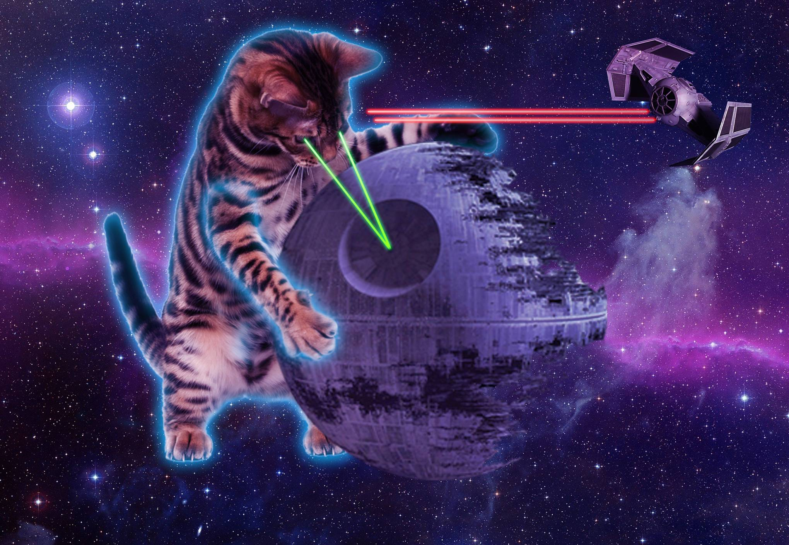
9.1 notes 278
American story. -Washington was a muddy mess at first.
The Election of 1800- Bitter campaign. Adams&Pinckney vs Jefferson&Burr
Election was different than today. They didn’t travel around campaigning. They just wrote nasty letters.

Slide 41
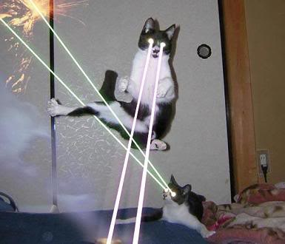
9.1 notes p. 279
Election deadlock
The election of 1800 was strange because even though Jefferson won, he tied with Burr his vice president for votes.
This meant that the House of Representatives would ultimately decide the 1800 election. They finally decided to put Jefferson into office.

Slide 42
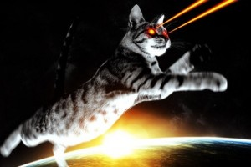
9.1 notes p. 279
Jefferson’s inauguration
Adams didn’t even watch the inauguration he was so angry.
Jefferson tried to bring the two parties to some kind of unity.
Jefferson believed in small government and Laissez-Faire (let the people do as they choose)

Slide 43
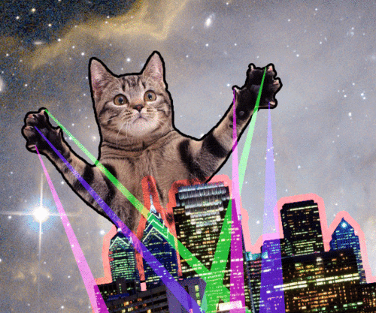
9.1 notes p. 280
Jefferson’s policies
Wanted to cut debt.
Reduce size of military
Jefferson’s cabinet
Secretary of State James Madison
Secretary of Treasury Albert Gallatin
Cutting costs.
Cut army by 1/3 reduced navy too!
It worked The national debt was reduced.

Slide 44
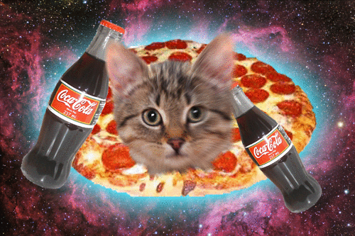
9.1 notes p. 280-281
Jefferson and the courts-
Judiciary act of 1801-
This act set up our regional court system
It created a lot of new jobs in the Judicial System
The president gets to appoint those positions
Adams hated Jefferson so he frantically appointed ALL of the positions so Jefferson would not have the opportunity to appoint anyone. LOL what a jerk!

Slide 45
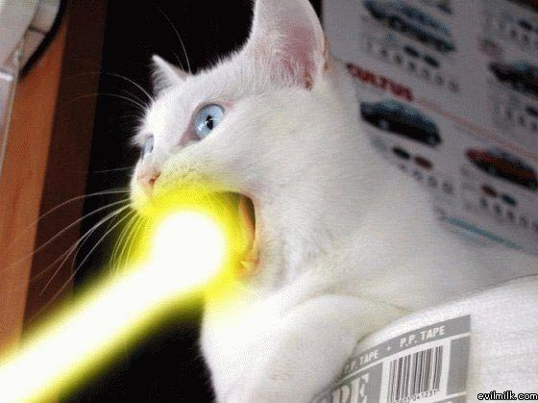
9.1 notes p. 281
Marbury v. Madison
Marbury took this issue to the supreme court.
John Marshal (supreme court justice) decided the court could not hear this case and also added the principal of Judicial Review to the court’s powers in his decision.

Slide 46
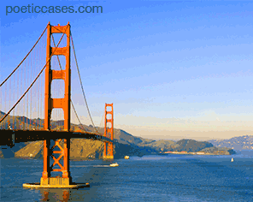
The Louisiana Purchase 9.2 p 282
An American Story
People moved west
Western Territory
Moving from the East coast over the Appalachian Mountains was hard.
People used Conestoga Wagons to travel to new lands.
When people got to the Mississippi River they had to stop. Land west of the river belonged to Spain

Slide 47
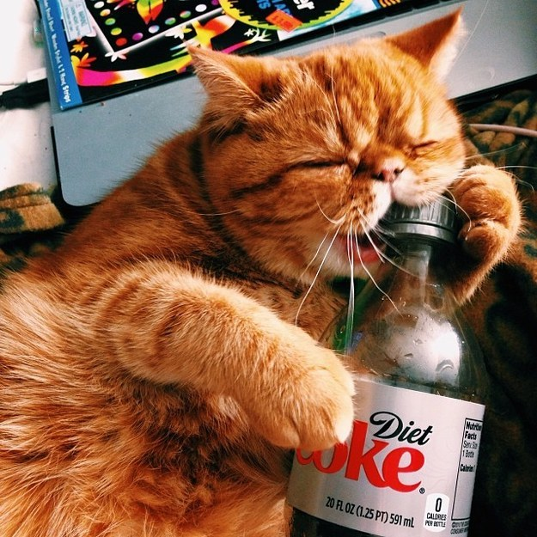
9.2 notes p. 283
The French Threat
In 1802 Spain suddenly stopped letting the US use the Mississippi River.
Jefferson learned that Spain had secretly given the Louisiana Territory back to France.
Jefferson authorized Robert Livingston to travel to France and offer up to 10 Million dollars for New Orleans and the lands surrounding it.

Slide 48
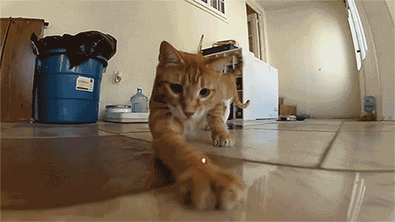
9.2 notes p. 283
Revolt in Santo Domingo
France lost Santo Domingo when Toussaint-Loverture led a rebellion and kicked France out
The Nation Expands
Without Santo Domingo, Napoleon didn’t need Louisiana.
He countered Jefferson’s offer and sold all of Louisiana to the US for 15 Million dollars.

Slide 49
9.2 notes p. 284
Lewis and Clark
Jefferson wanted to learn more about the Louisiana purchase.
He sent out Lewis and Clark to explore the LA Territory.
The expedition started in St. Louis and was aided by Sacagawea (a native woman) and an African American named York along the way.
Pikes Expedition
Zeb pike led a similar expedition and explored Colorado. Pikes peak was named after him. He called it Grand Peak

Slide 50
9.2 notes p. 285
Federalists plan to secede
Many federalists opposed the Louisiana Purchase
A group of federalists in Massachusetts plotted to secede (withdraw) from the Union and form a “Northern Confederacy”
They wanted New York to join them. They thought with New York and Massachusetts they could form a stable country.
They got former Vice president Aaron Burr to join their cause and run for Governor of New York He lost.
Hamilton accused Burr of treason and Burr challenged Hamilton to a duel.
Burr killed Hamilton in the Duel and fled.

Slide 51
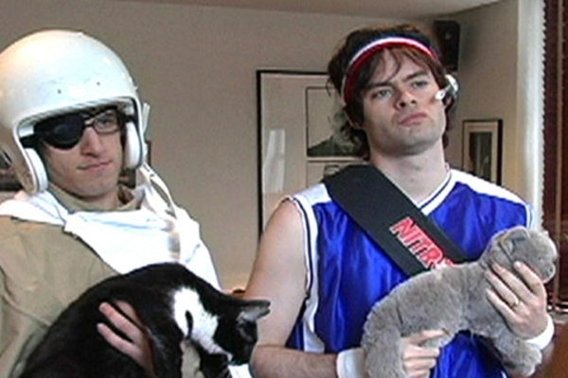
9.3 A time of Conflict p. 288
An American Story- it was risky to sail in the early 1800’s
Americans in Foreign Seas
Americans depended upon trading overseas
Barbary Pirates
One of the dangers in shipping was piracy
War with Tripoli
The US had a small-scale war with the pirates in Tripoli.
Stephen Decatur burned the Naval ship the Philadelphia to keep it out of Pirates hands.

Slide 52
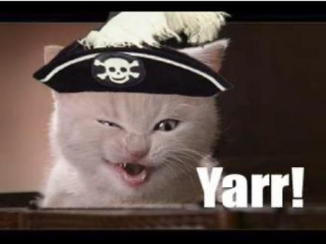
9.3 notes p 290
Freedom of the Seas
Jefferson easily won a second term as president
Britain and France were fighting and their conflict drug America in.
American Neutral rights were violated
American Sailors were kidnapped by the British (impressment)

Slide 53
9.3 notes p. 290
Attack on the Chesapeake
If the Americans refused to let the British board their ships the British would attack. The British attacked the Chesapeake and killed 3.
Jefferson did not want a war with Britain.
A disastrous trade ban
Instead of war Jefferson tried to hurt Britain with the Embargo Act. It prevented trade with Britain and ALL other countries. It crippled the American Economy! It was repealed and replaced with the weaker Non-Intercorse ACT. It stopped trade with Britain and France.

Slide 54
9.3 notes p. 291
Jefferson leaves office
Jefferson did not run for a third term. His party the Democratic Republicans chose James Madison for their candidate. The Federalists chose Charles Pinckney. Madison won in a landslide.
War Fever
Madison faced a strong call for war.
Closer to War
Napoleon tricked Madison into easing trade restrictions. He continued seizing American Ships.
Madison still thought Britain more of a threat to the United States.

Slide 55
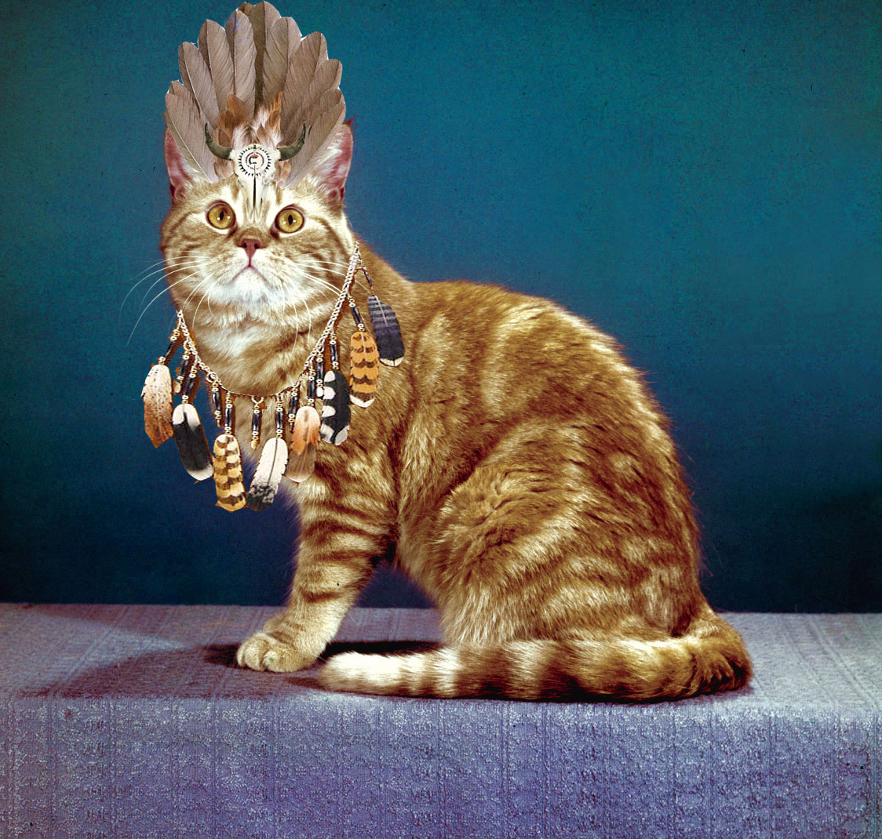
9.3 notes p. 292
Frontier Conflicts
Native Americans built a confederation led by Tecumseh.
With British backing the Native Americans built Prophetstown and attempted to halt settlement of Whites in their lands.
A meeting with Harrison
William Henry Harrison was worried about Tecumseh and his brother the Prophet.
The Prophet taught the Native Americans to return to their ancestral customs.
Harrison destroyed Prophetstown on the Tippecanoe River.
This pushed Tecumseh into further alliance with the British.

Slide 56
Spoilers!
I will not behave like a child in Bear Time. X 100
The false Prince
Connor dies in a pirate attack at the end.
Time after time
Bennet is revealed to not be time traveler but instead is in an insane asylum suffering a mental breakdown and imagining his relationship with Anna

Slide 57
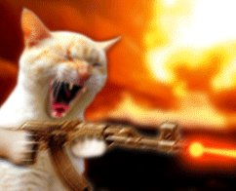
9.3 notes p. 293
War Hawks
A group of Democratic Republicans begged for War. They were known as War Hawks.
The War Hawks were led by Henry Clay and John Calhoun. They had strong Nationalism. They urged for major military spending.
Declaring War
Madison declared war on Britain in 1812.

Slide 58
Lewis And Clark
Brainstorm a list of reason’s why the Louisiana territory would have been important to Americans during President Jefferson’s time.
What information were Lewis and Clark collecting for Jefferson?
In your own words describe the routes that they took.

Slide 59
Answers Lewis and Clark
Logging
Scientific expedition
Settlements.
Make country bigger
To see what animals and plants were west
To learn what was available to trade with N. Americans.
To see if there are valuable resources
To see if the British and Spanish were already building settlements.
They were based on rivers.
They used horses
They traveled East to West and returned West to East.
They crossed the Rocky Mountains and Great Plains

Slide 60
9.4
Our military started the war of 1812 in a weak state.
We underestimated the British.
Oliver Hazzard Perry won an important battle at lake Erie.
In the Battle of the Thames the Americans killed Tecumseh.
The USS Constitution was named “Old Ironsides”

Slide 61
9.4
Andrew Jackson fought against the Creek people at Horseshoe Bend.
In 1814 the British defeated Napoleon in Europe. Now they could focus on just the Americans. Uh OH.
In August 1814 the British attacked Washington DC. They burned most of the city to the ground. A hurricane put out the fires.
This was the worst defeat of the war for the Americans.

Slide 62
9.4
The British decided to move from Washington to Baltimore.
Baltimore held out against the British.
Francis Scott Key wrote the Star Spangled Banner about this battle.
Americans stopped the British on Lake Champlain this ended the war.
The Treaty was signed in Ghent Belgium.

Slide 63
9.4
Before news of the treaty reached America, the biggest battle of the war took place in New Orleans.
Americans ambushed/crushed the British in this battle.
Most Americans felt proud of their nation after the war of 1812.
This war basically ended the Federalist Party because they had opposed this war.

Slide 64
9.3
PROTECTION MONEY is tribute.
STEPHEN DECATUR was a navy captain.
A powerful Shawnee leader was TECUMSEH.
Tecumseh’s brother and ally was THE PROPHET.
WILLIAM HENRY HARRISON attacked Prophetstown.
B. CLAY AND CALHOUN were leading War Hawks.
C. IMPRESSMENT was a violation of neutral rights.
C. The EMBARGO ACT was repealed on March 1st 1809.
A. Tecumseh joined forces with Great Britain after the BATTLE of TIPPECANOE.
C. The president was pressured to declare war on Great Britain by THE WAR HAWKS were mauled by a bear.

Slide 65
9.4
Commander of the Lake Erie naval forces is Oliver Hazard Perry.
Frigates are war ships.
The Constitution is called Old Ironsides.
Privateers are armed Private ships.
Andrew Jackson attacked the Creeks.
A. The great leader Tecumseh was killed at the battle of the Thames.
C. With the death of Tecumseh the hopes died for a native American confederation.
A. One of the buildings burned by the British was the capitol.
C. The Star Spangled banner was written by Francis Scott Key.
C. The Battle of New Orleans helped Andrew Jackson win the presidency in 1828.

