Slide 1
Main Idea. 9-8
Homework on the roldium (rolly podium). Write the following paragraph.
Many explorations took place in the 1400s and 1500s and as early as A.D. 1000 when Leif Eriksson landed in present-day Newfoundland. The explorers represented the strongest countries in Europe. They were searching for new trade routes and riches. Many people died in the Crusades which was also at this time. In the late 1400s, Dias, Columbus, and da Gama set sail. Explorers such as Magellan, Cartier, De Soto, and Hudson all followed in the next 50 years. In 1565 Spain established the first settlement at St. Augustine Florida.
What is the main Idea of this paragraph.
Which sentence could be omitted (left out)
Create one sentence of your own that could be added and still fit the main idea.

Slide 2
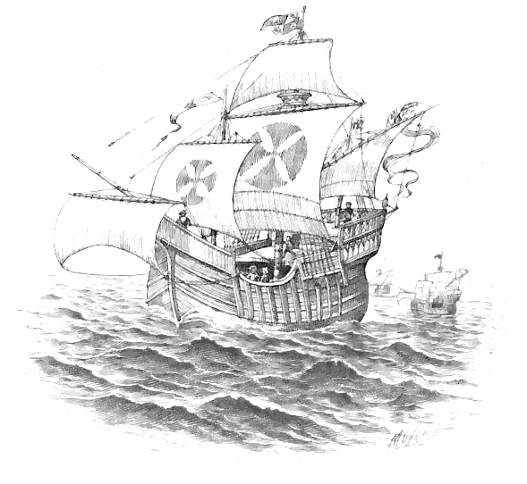
9-22 and 9-23
There were many factors that led to the discovery of the American Continent. Some are listed below. Pick which one you believe played the biggest role, and explain why.
New navigation technology like the astrolabe and better ships.
The invention of the printing press.
The Crusades made Europeans want to find Asian goods.

Slide 3
Write the following paragraph in your notes.
New trade routes led to the discovery of America. Thanks to the Crusades, and books like Travels by Marco Polo, the Europeans wanted spices and other Asian goods such as coffee, sugar, gunpowder and silk. Muslim pirates and vast distances made the goods expensive. Many European nations such as Spain and Portugal, began to look for new routes to Asia. Columbus underestimated the size of the Earth. He thought he could sail around the world to Asia. In 1492, Columbus tried to sail west to Asia. He unknowingly discovered America!
Find all of the details in this paragraph, could you improve it?

Slide 4
Homework on the podium/ grab your papers from the stool.
For your bell ringer today you will copy your two essays from the test. Copy them exactly as you wrote them onto a sheet of notebook paper. Do not put your name on it yet! Instead put a birthdate or code word that will let you identify it! Also do not score the essays in any way. We will do that in class.

Slide 5
9-24 and 9-25
The European nations had various agenda’s when it came to America.
The French wanted to trade with Indians
The Spanish wanted to take foreign gold.
The Dutch wanted to find a way around America.
The English wanted to colonize America.
Which agenda do you identify with the most? Why?

Slide 6
Bell Ringer
Using your notes and your memory, make a 5 question pop quiz over the material we learned in the last couple of class periods.
(conquest of the Aztec and Inca, and World Religions)
Please try to make the questions moderately difficult (not too easy not too hard)
You will give this five question quiz to a partner LATER! So be sure it is legible.

Slide 7
White day classes had no homework.
chose 1 of these essays and write an answer using your book. For the other question, make notes that will allow you to discus it.
Explain how technology made long sea voyages possible?
Can you relate how the great civilizations of Africa arose and flourished?

Slide 8
Spanish Social Classes Table
peninsulares who owned land, ran the local government, and served in the Catholic Church.
creoles, or people born in the Americas to Spanish parents.
mestizos, or people with both Spanish and Native American parents.
Native Americans.
enslaved Africans.

Slide 9
Causes of exploration
Discovery
Fall of the roman empire
Strengthening of the catholic church
Dark ages
Crusades
People wanting to trade with Asia
Renaissance and end of dark ages
New technology

Slide 10
Beartime
Today we will make a newspaper. It is about topics in chapter 2. These topics will include:
Technology
Exploration
African nations
The Renaissance
And a topic of your choice from the chapter

Slide 11
Technology
Technology was very important in the 1400’s and 1500’s. There were many inventions that helped people to explore this planet.
The astrolabe was a tool used by sailors to help them navigate. It helped explorers like Dias and Columbus to make dangerous sea voyages.
The Caravel was a powerful ship. It was better in many ways to the other ships that came before it. The caravel could haul more cargo and move faster than previous types of ships.
Thanks to many inventions like the caravel and astrolabe (among others) exploration became possible during the 1400’s and 1500’s

Slide 12
9-22 and 9-23
There were many factors that led to the discovery of the American Continent. Some are listed below. Pick which one you believe played the biggest role, and explain why.
New navigation technology like the astrolabe and better ships.
The invention of the printing press.
The Crusades made Europeans want to find Asian goods.

Slide 13
Have kids take bell ringer quiz
Homework on the podium!
And grade bell ringer quizzes
Phase 1. Trade your quizzes with a neighbor.
Phase 2. take your neighbor’s quiz.
Phase 3. Give it back to your neighbor.
Phase 4. After you get it back grade it.
Phase 5. Discuss with your neighbor any questions you missed. Try to identify what went wrong, and what they were expecting.

Slide 14
essays
Practice the essay questions.
Make sure the kids have the essays written down to study.
essay 1. How did the need for new trade routes lead to the discovery of America?
Essay 2. Explain how technological advances helped bring about the discovery of America.
Essay 3. Explain the conquest of the Aztec.
essay 4 Explain how the Protestant Reformation relates to the Age of Exploration.

Slide 15
Chapter Objectives
Section 1: A Changing World
Examine how technology made long sea voyages possible.
Explore the factors that allowed great civilizations in Africa to flourish.
Click the mouse button or press the Space Bar to display the information.

Slide 16
Chapter Objectives
Section 2: Early Exploration
Explain Portugal’s leadership roles in exploration.
Understand Columbus’s plan for sailing to Asia.

Slide 17
Chapter Objectives
Section 3: Spain in America
Evaluate the decline of the Aztec and Inca Empires in the Americas.
Explore how Spain governed its empire in the Americas.

Slide 18
Chapter Objectives
Section 4: Exploring North America
Explain how the Protestant Reformation affected North America.
Evaluate why the activities of early traders encouraged exploration.

Slide 19
Why It Matters
Although the English have been the major influence on United States history, they are only part of the story. Beginning with Native Americans and continuing through time, people from many cultures came to the Americas.

Slide 20
The Impact Today
Before 1492, the cultures that arose in the Americas had almost no contact with the rest of the world. The Great Convergence—the interactions among Native Americans, Europeans, and Africans—shaped the history of the Americas.

Slide 21
Guide to Reading
Main Idea
New knowledge and ideas led Europeans to explore overseas.
Key Terms
classical
caravel
pilgrimage
mosque
Renaissance
technology
astrolabe

Slide 22
Guide to Reading (cont.)
Reading Strategy
Determining Cause and Effect As you read the section, re-create the diagram on page 38 of your textbook and identify three reasons Europeans increased overseas exploration.
how technology made long sea voyages possible.
how great civilizations flourished in Africa.

Slide 23
Guide to Reading (cont.)
Section Theme
Culture and Traditions The spirit of the Renaissance changed the way Europeans thought about the world.

Slide 24
9-22 and 9-23
There were many factors that led to the discovery of the American Continent. Some are listed below. Pick which one you believe played the biggest role, and explain why.
New navigation technology like the astrolabe and better ships.
The invention of the printing press.
The Crusades made Europeans want to find Asian goods.

Slide 25
Section 1-5
Expanding Horizons
Marco Polo’s book, Travels, written in 1296–97, described his travels to Asia.
It inspired Columbus and other explorers to journey to these lands 200 years later.
The cities of Venice, Genoa, and Pisa became centers of the growing trade in goods such as spices, silks, perfumes, and precious stones.
(pages 38–39)
Click the mouse button or press the Space Bar to display the information.

Slide 26
Section 1-6
Expanding Horizons (cont.)
The Renaissance, a period of renewed interest in classical Greek and Roman learning, spread throughout Europe in the 1400s!
It encouraged Europeans to pursue new ideas and challenges and set the stage for exploration and discovery.
(pages 38–39)
Click the mouse button or press the Space Bar to display the information.

Slide 27
Section 1-7
Expanding Horizons (cont.)
Why do you think Western European explorers found Asia so interesting?
Possible answer: Europeans had the ideas of becoming wealthy through foreign trade and learning about lifestyles in distant lands.
(pages 38–39)
Click the mouse button or press the Space Bar to display the answer.

Slide 28
Section 1-8
Powerful Nations Emerge
The development of large nation-states in Western Europe helped spark foreign trade and travel outside the region.
The monarchies of Spain, Portugal, England, and France looked for ways to increase the power and wealth of their countries.
(pages 39–40)
Click the mouse button or press the Space Bar to display the information.

Slide 29
Section 1-9
Powerful Nations Emerge (cont.)
Why was it necessary for monarchs to work at building powerful and wealthy countries?
Possible answer: Countries wanted to appear powerful so they would not be invaded and overtaken by any other country. Wealth would allow the monarch to outfit a powerful army that could defend the country or invade another country.
(pages 39–40)
Click the mouse button or press the Space Bar to display the answer.

Slide 30
Section 1-10
Technology’s Impact
Better maps and navigational instruments, such as the astrolabe and compass, helped navigators more accurately determine direction and location.
as well as larger and sturdier sailing vessels, such as the caravel, enabled sailors to travel faster and carry more people, cargo, and food.
These advances enabled sailors to explore new routes. especially a sea route to Asia.
(pages 40–41)
Click the mouse button or press the Space Bar to display the information.

Slide 31
Section 1-11
Technology’s Impact (cont.)
Portugal and Spain began searching for routes to Asia and traveled south to the West Coast of Africa.
(pages 40–41)

Slide 32
Section 1-12
Technology’s Impact (cont.)
How does modern technology make our lives easier?
Possible answer: Modern technology helps us do things better, faster, more efficiently, and cost effectively.
(pages 40–41)
Click the mouse button or press the Space Bar to display the answer.

Slide 33
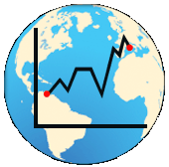
Section 1-13
African Kingdoms
Three West African kingdoms flourished: Ghana, Mali, and Songhai.
Ghana was a huge trading empire between 400 and 1100.
Its trade in gold and salt contributed to its prosperity.
When Ghana’s power declined, the empire saw new states emerge.
(pages 41–42)
Click the mouse button or press the Space Bar to display the information.

Slide 34
Section 1-14
African Kingdoms (cont.)
Mali and its capital, Timbuktu, became important Islamic centers. Mansa Musa, who ruled Mali from 1312 to 1337, was its greatest king.
He made a pilgrimage to Makkah (also spelled Mecca), the Muslim holy city.
The Songhai Empire arose in the late 1400s and became the largest in the history of West Africa.
(pages 41–42)
Click the mouse button or press the Space Bar to display the information.

Slide 35
Section 1-15
African Kingdoms (cont.)
The Songhai Empire arose in the late 1400s and became the largest in the history of West Africa.
Its ruler, Askìya Muhammad, encouraged trade with Europe and Asia and introduced to his country a legal system, a system of government, and schools.
The empire fell in the late 1500s when the Moroccans attacked its trade centers.
(pages 41–42)
Click the mouse button or press the Space Bar to display the information.

Slide 36
Section 1-16
African Kingdoms (cont.)
Why did great empires arise in Africa?
The resources of the land, the trade with North Africa, and powerful rulers helped create these great empires.
(pages 41–42)
Click the mouse button or press the Space Bar to display the answer.

Slide 37
Section 1-17
Checking for Understanding
Define Match the terms on the right with their definitions on the left.
__ 1. a period of intellectual and artistic creativity, c. 1300–1600
__ 2. an instrument used by sailors to observe positions of the stars
__ 3. relating to ancient Greece and Rome
__ 4. the application of scientific discoveries to practical use
__ 5. small, fast ship with a broad bow
A. classical
B. Renaissance
C. technology
D. astrolabe
E. caravel
B
D
A
C
E
Click the mouse button or press the Space Bar to display the answers.

Slide 38
Causes of exploration
Discovery
Fall of the roman empire
Strengthening of the catholic church
Dark ages
Crusades
People wanting to trade with Asia
Renaissance and end of dark ages
New technology

Slide 39
41 on a 32 on b
Write the following paragraph in your notes.
New trade routes led to the discovery of America. Thanks to the Crusades, and books like Travels by Marco Polo, the Europeans wanted spices and other Asian goods such as coffee, sugar, gunpowder and silk. Muslim pirates and vast distances made the goods expensive. Many European nations such as Spain and Portugal, began to look for new routes to Asia. Columbus underestimated the size of the Earth. He thought he could sail around the world to Asia. In 1492, Columbus tried to sail west to Asia. He unknowingly discovered America!
Find all of the details in this paragraph, could you improve it?

Slide 40
Seeking New Trade Routes
The Portuguese were the leaders of early exploration.
They hoped to find a new route to China and India.
They also helped to find a more direct way to get West African gold.
Prince Henry of Portugal (also called Henry the Navigator) set up a center for exploration so that scientists could share their knowledge with shipbuilders and sailors.

Slide 41
Seeking New Trade Routes (cont.)
Ships sailed south along the coast of West Africa (also called the Gold Coast) where they traded for gold and ivory and began buying slaves in the mid-1400s.
In 1487 Bartholomeu Dias explored the southernmost part of Africa.
This became known as the Cape of Good Hope.
The king of Portugal hoped the passage around the tip of Africa would lead to a new route to India.

Slide 42
Seeking New Trade Routes (cont.)
In 1497, Vasco da Gama sailed around the Cape of Good Hope.
He visited East African cities and reached India in 1498.

Slide 43
Columbus Crosses the Atlantic
The Vikings reached North America and established settlements in Iceland and Greenland in the 800s and 900s.
Viking sailor Leif Eriksson explored land west of Greenland known as Vinland about the year 1000.
Historians think that Vinland was North America.
No one is sure what other parts of North America the Vikings explored.

Slide 44
Columbus Crosses the Atlantic (cont.)
Queen Isabella of Spain sponsored Columbus on his first voyage in August 1492.
He set out with three ships to find a route to Asia.
On October 12, 1492, he spotted land, named it San Salvador, and claimed it for Spain.
He did not know that he had reached the Americas. He was convinced that he had reached the East Indies.

Slide 45
Columbus Crosses the Atlantic (cont.)
Columbus made three additional voyages in 1493, 1498, and 1502.
He explored the Caribbean islands of Hispaniola, Cuba, and Jamaica and sailed along the coasts of Central America and northern South America.
He claimed these lands for Spain.

Slide 46
Columbus Crosses the Atlantic (cont.)
The Treaty of Tordesillas was signed by Spain and Portugal to clarify the line of demarcation between their lands in the Americas.
The treaty moved the line farther west so that Portugal would not be at a disadvantage.
Spain was to have control of all the lands to the west of the line, and Portugal was to have control of all the lands to the east of the line.

Slide 47
Columbus Crosses the Atlantic (cont.)
Amerigo Vespucci mapped South America’s coastline in 1499.
He concluded South America was a continent, but not part of Asia.
European geographers called the continent America, in honor of Amerigo Vespucci.
Vasco Núñez de Balboa claimed the Pacific and adjoining lands for Spain.

Slide 48
Columbus Crosses the Atlantic (cont.)
Ferdinand Magellan, sailing from Spain in 1519, found a passage to the Pacific, the Strait of Magellan.
Magellan sailed around South America and toward Spain.
Magellan was killed in an island battle along the way, but a small number of his crew made it all the way to Spain.
The crew became the first to circumnavigate the world.

Slide 49
Guide to Reading (cont.)
Reading Strategy
Organizing Information As you read the section, re-create the diagram on page 51 of your textbook and identify Spanish conquistadors, along with the regions they explored.
Read to Learn
how the great Aztec and Inca Empires came to an end.
how Spain governed its empire in the Americas.

Slide 50
Guide to Reading (cont.)
Section Theme
Culture and Traditions The conquistadors conquered mighty empires in the Americas.

Slide 51
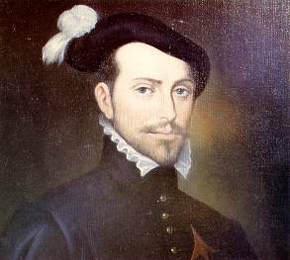
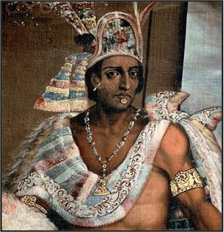
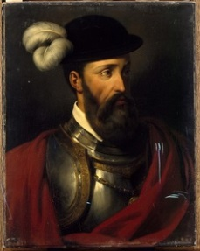
Spanish Conquistadors
Conquistadors were Spanish explorers who settled in the Americas.
They received land grants from Spanish rulers in exchange for one-fifth of gold or treasure taken from the Americas.
In 1521 Hernán Cortés conquered the Aztec capital of Tenochtitlán.
He took their emperor Montezuma prisoner and gained control of the region.
Francisco Pizarro captured the Inca ruler Atahualpa in 1532 and later gained control of the Inca Empire.
(pages 51–53)

Slide 52
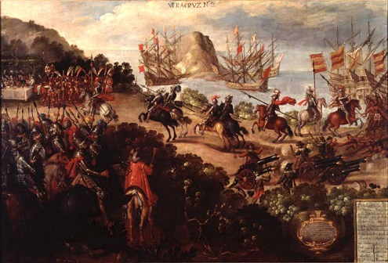
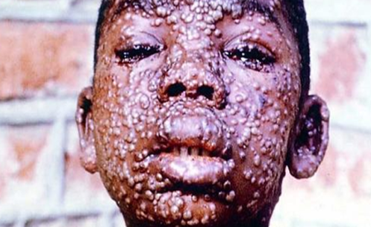
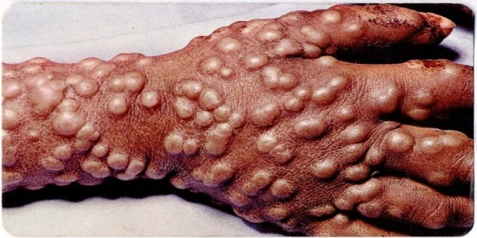
Spanish Conquistadors (cont.)
The Spanish conquistadors conquered great Native American empires with their strong armies using guns, cannons, and horses.
The invaders also received the help of the Native Americans in overthrowing many existing rulers.
Because the Native Americans had no immunity to European diseases, many of them became sick and died.

Slide 53
Section 3-8
Spain in North America
Spanish conquistadors also explored the southeastern and southwestern parts of North America in hopes of finding riches.
Juan Ponce de León landed on the east coast of present-day Florida in 1513, looking for gold and the “fountain of youth.”
In 1565 the first Spanish settlement in the United States, a fort, was established at St. Augustine, Florida.
(pages 53–54)
Click the mouse button or press the Space Bar to display the information.

Slide 54
Section 3-9
Spain in North America (cont.)
Many conquistadors searched for wealth and the “Seven Cities of Cibola.”
Some lost their lives as they searched for these cities because of stormy weather, lack of supplies, and illness.
Álvar Núñez Cabeza de Vaca and Pánfilo de Narváez explored Florida and the coast of Mexico.
In 1541 Hernando de Soto explored the southeastern region of North America.
(pages 53–54)
Click the mouse button or press the Space Bar to display the information.

Slide 55
Section 3-10
Spain in North America (cont.)
He crossed the Mississippi River and traveled as far west as present-day Oklahoma.
Francisco Vásquez de Coronado traveled through northern Mexico and present-day Arizona and New Mexico.
In 1540 he reached a town belonging to the Zuni people, but found no gold.
(pages 53–54)
Click the mouse button or press the Space Bar to display the information.

Slide 56
Spanish Rule
The Spanish established three kinds of settlements in the Americas.
Pueblos or towns were centers of trade.
Missions were religious communities.
Presidios were forts and usually built near a mission.
The hierarchy of the social classes from upper to lower included:

Slide 57
Spanish Social Classes Table
peninsulares who owned land, ran the local government, and served in the Catholic Church.
creoles, or people born in the Americas to Spanish parents.
mestizos, or people with both Spanish and Native American parents.
Native Americans.
enslaved Africans.

Slide 58
Spanish Rule (cont.)
The Spanish developed a system of encomiendas that enslaved Native Americans.
A conquistador could demand taxes and labor from the Native Americans living on the land.
Many Native Americans died from malnutrition and disease. because of this grueling labor.

Slide 59
Spanish Rule (cont.)
Bartolomé de Las Casas, a priest, fought against this harsh treatment.
As a result, Spain passed the New Laws in 1542 that forbade enslaving Native Americans.
In the mid-1500s, Africans were transported from West Africa to replace enslaved Native Americans.
As a result, slave labor became an essential part of the Spanish and Portuguese economies.
Click the mouse button or press the Space Bar to display the information.

Slide 60
Spanish Rule (cont.)
The Spanish also developed the plantation system, or large estate.
In the mid-1500s, Africans were transported from West Africa to replace enslaved Native Americans.
As a result, slave labor became an essential part of the Spanish and Portuguese economies.

Slide 61
End of Section 3

Slide 62
Guide to Reading
Main Idea
Rivalries between countries, the search for a Northwest Passage to Asia, and early trading activities led to increased exploration of North America.
Key Terms
mercantilism
Northwest Passage
coureur de bois
Columbian Exchange

Slide 63
Guide to Reading (cont.)
Reading Strategy
Determining Cause and Effect As you read the section, re-create the diagram on page 58 of your textbook and provide an effect for each cause.
Read to Learn
how the Protestant Reformation affected North America.
why the activities of early traders encouraged exploration.

Slide 64
Guide to Reading (cont.)
Section Theme
Global Connections European nations competed for overseas land and resources.

Slide 65
A Divided Church
Martin Luther brought about changes in Europe in the 1500s with his opposition to Catholicism.
His protests began the Protestant Reformation.
In France, John Calvin, a Christian theologist, broke away from the Catholic Church.
For personal reasons, King Henry VIII established England as a Protestant nation.

Slide 66
A Divided Church (cont.)
When Europeans settled in America, they brought with them their religious beliefs of either Catholicism or Protestantism.

Slide 67
Economic Rivalry
The exploration of the Americas created rivalries between European countries to acquire colonies there.
These colonies provided resources and a market to sell European products.

Slide 68
Economic Rivalry (cont.)
The Columbian Exchange was a two-way exchange between the Americas and Europe, Asia, or Africa.
The exchange included crops, livestock, and other goods for enslaved Africans who worked on the plantations.
Disease was a result of this exchange since Native Americans did not have the immunity to fight off European germs.

Slide 69
Economic Rivalry (cont.)
England, France, and the Netherlands searched for a more direct route to Asia to compete with Spain and Portugal, who had claimed most of the Americas.
This became known as the Northwest Passage. Instead of traveling around South America, they sailed along the northern coast to North America.
John Cabot working for probably landed on the coast of Newfoundland in 1497.
England was then able to establish claims in North America.

Slide 70
Economic Rivalry (cont.)
Giovanni da Verrazano sailed for France in 1524 and explored the coast of North America from present-day Nova Scotia south to the Carolinas.
Jacques Cartier also sailed for France. He sailed up the St. Lawrence River and founded Mont-Royal (Montreal).
Henry Hudson sailed for the Dutch. He discovered the Hudson River in 1609. He sailed as far north as Albany. In 1610 he discovered Hudson Bay, thinking that he had reached the Pacific Ocean.
Click the mouse button or press the Space Bar to display the information.

Slide 71
Economic Rivalry (cont.)
He and his crew were unsuccessful in finding an outlet.
In the 1600s France and the Netherlands set up trading posts in the Americas.

Slide 72
Economic Rivalry (cont.)
They were interested in economic opportunities, not building an empire.
Samuel de Champlain established a trading post for fur trading in Quebec and other parts of Canada.
The Dutch established trading posts along the Hudson River.

Slide 73
End of Slide Show

